Slide 1
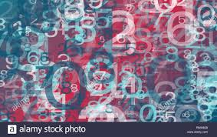
Machine Learning’s Image Processing A Practical Approach
Anton Georgescu
Principal Product Architect, TEMS
Standish, Ontario

Slide 2
Table of Content
What is image processing?
Why do we need to process images?
How does image processing work?
Digital image processing: spatial domain
Sample & Quantization
Image interpolation
Nyquist theorem for image reconstruction
Aliasing and image enhancement
Anti-aliasing for image enhancement
Arithmetic and logic operations
Image filtering
Digital image processing: frequency domain
Image transformation with Fourier transform
Using Discrete Fourier Transform (DFT)
Hands-on examples of image processing implemented with Python

Slide 3
What is image processing?
Image processing is a method to perform some operations on an image, in order to
get an enhanced image or
to extract some useful information from it
It is a type of signal processing in which
input is an image and
output may be image or characteristics/features associated with that image

Slide 4
Why do we need image processing?

Slide 5
How does image processing work?
Includes the following three steps:
import the image via image acquisition tools
analyze and manipulate the image
output the altered image or provide report based on image analysis
Two types of methods used for image processing:
analogue image processing
can be used for the hard copies like printouts and photographs
digital image processing
manipulation of the digital images by using computers
require three general phases: 1) pre-processing; 2) enhancement; 3) display;

Slide 6
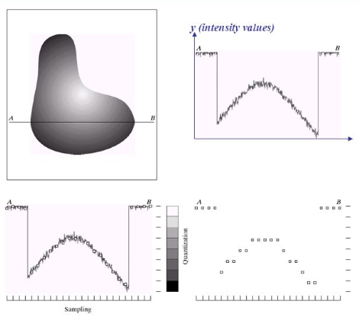
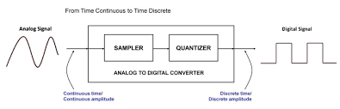
Sample & Quantization
a digitizer is used to sample and quantize the analogue video signal
in order to create an image which is digital, we need to convert continuous data into digital form
there are two steps in which it is done:
Sampling
Quantization
the sampling rate determines the spatial resolution of the digitized image
the quantization level determines the number of grey levels in the digitized image

Slide 7
Image interpolation
Image interpolation occurs when you resize or distort your image from one pixel grid to another.
Image resizing is necessary when you need to increase or decrease the total number of pixels Image remapping can occur when you are correcting for lens distortion or rotating an image. Zooming refers to increase the quantity of pixels, so that when you zoom an image, you will see more detail.
Image interpolation is a great technique to make up for the missing values in an image (a.k.a. “data loss” that we covered in the previous presentation)
Interpolation works by using known data to estimate values at unknown points.
It works in two directions
tries to achieve a best approximation of a pixel's intensity based on the values at surrounding pixels.
Common interpolation algorithms can be grouped into two categories:
Adaptive methods - change depending on what they are interpolating
Adaptive algorithms include many proprietary algorithms in licensed software such as:
Qimage, PhotoZoom Pro and Genuine Fractals
Non-adaptive methods – treat all pixels equally
Non-adaptive algorithms include:
Nearest neighbor, bilinear, bicubic, spline, sinc, lanczos and others.
Interpolation used in compact digital cameras that have both an optical and a digital zoom
A camera performs an optical zoom by moving the zoom lens so that it increases the magnification of light
A digital zoom degrades quality by simply interpolating the image. Even though the photo with digital zoom contains the same number of pixels, the detail is clearly far less than with optical zoom

Slide 8
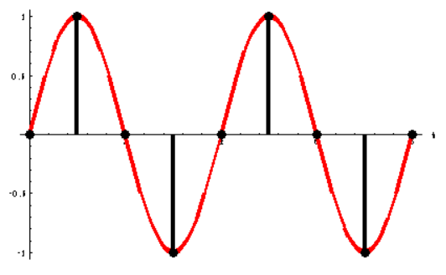
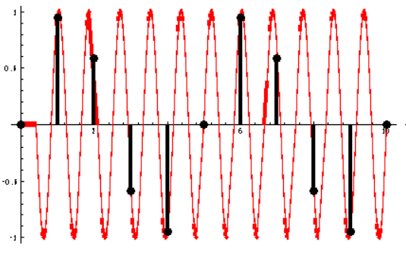
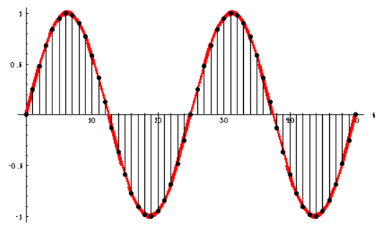
Nyquist theorem for image reconstruction
Nyquist Sampling Theorem states that: A bandlimited continuous-time signal can be sampled and perfectly reconstructed from its samples if the waveform is sampled over twice as fast as it's highest frequency component.
High Sampling Rate (Oversamped) = much greater than 2X the highest frequency. This is 'Oversampling' that, while not "bad" will take time and create a large digital file.
Nyquist Sampling Rate = The minimum sample rate that captures the "essence" of the analog information. Note that while Nyquist is appropriate for sampling, it may not capture nuances in information. But, of course, those nuances are higher frequency, and thus would require a higher Nyquist sample rate.
Low Sampling Rate (Undersampled): low sampling rate produces results that report false information about the analog data; which does not represent the original. This phenomenon is called aliasing.

Slide 9
Sampling and image reconstruction
Since a sampler is a linear system, then if an input is a sum of sinusoids, the output will be a sum of sampled sinusoids
This suggests that if the input contains no frequencies above the Nyquist frequency, then it will be possible to reconstruct each of the sinusoidal components from the samples.
This is an intuitive statement of the Nyquist-Shannon sampling theorem.

Slide 10
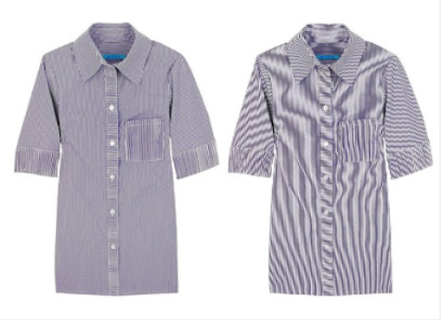
Aliasing and image enhancement
Aliasing occurs when a signal is sampled at a less than twice the highest frequency present in the signal
Aliasing is characterized by the altering of output compared to the original signal because resampling or interpolation resulted in a lower resolution in images
In a digital image, aliasing manifests itself as a moiré pattern or a rippling effect.
This spatial aliasing in the pattern of the image makes it look like it has waves or ripples radiating from a certain portion
This happens because the *pixelation of the image is poor; when our eyes interpolate those pixels, they simply do not look right
Sample of image distorted by Moiré effect
*Pixelation is the term used in computer graphics to describe blurry sections or fuzziness in an image due to visibility of single-colored square display elements or individual pixels

Slide 11
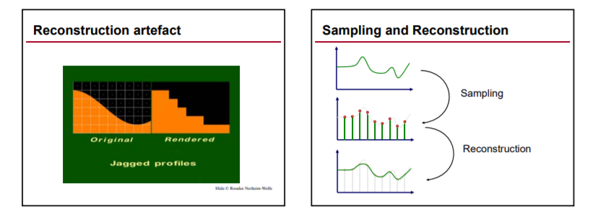
Anti-aliasing for image enhancement
Anti-aliasing is a process which attempts to minimize the appearance of aliased diagonal edges.
Anti-aliasing gives the appearance of smoother edges and higher resolution.
It works by taking into account how much an ideal edge overlaps adjacent pixels.
Image aliasing is the "jagged edge" effect caused by mapping curved and diagonal shapes onto square pixels.
Horizontal and vertical lines can be mapped perfectly onto square pixels, but angled and curved lines must be estimated. If pixels along the edge are either on or off, the result is a jagged edge, also called "stair-stepping" or aliasing.
The goal of an anti-aliasing algorithm is to make a digital image look natural when viewed from a typical viewing distance. When zoomed in, anti-aliased images and text may appear fuzzy because of the estimated pixels.

Slide 12
Anti-aliasing for image enhancement (cont’d)
Anti-aliasing is smoothing edges by estimating the colors along each edge.
Instead of pixels being on or off, they are somewhere in between
For example, a black diagonal line against a white background might be shades of light and dark grey instead of black and white.
A blue circle on a yellow background might have shades of blue, yellow, and green along the edges instead of solid blue and yellow.

Slide 13
Arithmetic and logic operations
Image arithmetic applies one of the standard arithmetic operations or a logical operator to two or more images.
The operators are applied in a pixel-by-pixel way, i.e. the value of a pixel in the output image depends only on the values of the corresponding pixels in the input images.
the images must be of the same size.
although image arithmetic is the most simple form of image processing, there is a wide range of applications.
main advantage of arithmetic operators is that the process is very simple and therefore fast.
Logical operators are often used to combine two (mostly binary) images
In the case of integer images, the logical operator is normally applied in a bitwise way.
Two categories of image operations:
Arithmetic: subtraction, averaging
Simple way to remove noise from an image by using image averaging
Logical: Not, And, OR

Slide 14
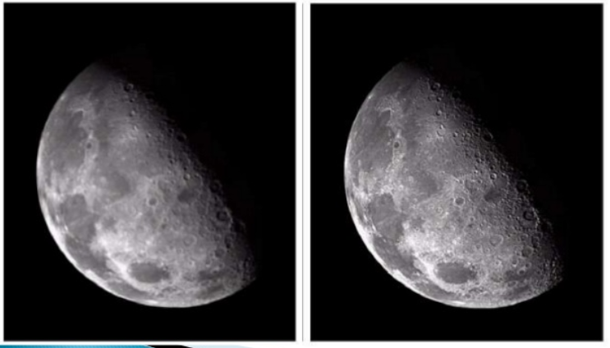
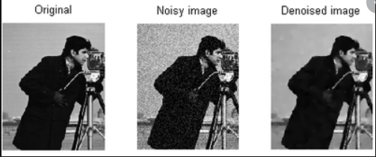
Image filtering
Image filtering is a popular tool used in image processing
we use image filtering to remove noise and any undesired features from an image, creating a better and an enhanced version of that image.
Two types of filters exist
Linear: mean (averaging) and Laplacian filter
Non-linear: median, minimum, maximum, and Sobel filters.
Applications of Laplace filter in image processing:
Image sharpening
Edge detection
*Blob detection
Example of image sharpening with Laplace filter
*In digital image terminology, a blob is an area that differ from the surrounding areas in a set of properties, like for example brightness and color
Image denoised with Laplace filter

Slide 15
Image transformation with Fourier transform
The Fourier Transform is an important image processing tool which is used to decompose an image into its sine and cosine components
The output of the transformation represents the image in the Fourier or frequency domain, while the input image is the spatial domain equivalent
In the Fourier domain image, each point represents a particular frequency contained in the spatial domain image
The Fourier Transform is used in a wide range of applications, such as image analysis, image filtering, image reconstruction and image compression.

Slide 16
Using Discrete Fourier Transform (DFT)
DFT means discrete Fourier transform
Fourier transform is a mathematical formula by which we can extract out the frequency domain components of a continuous time domain signal
Using Fourier transform we can process time domain signal in frequency domain
We can use various Frequency domain filters to process the signal
Discrete Fourier Transform is used to analyze digitized signals
Example: Image has changes in brightness level according to picture. The brightness changes in rows and columns.
We can consider brightness level in a row as a discrete signal 1D and we can apply DFT
Same way DFT is applied for each row or column and corresponding DFT row or column is generated
Thus DFT process transform 2D spatial domain image into 2D frequency domain image.
Using 2D frequency domain filters we can process images.

Slide 17
Hands-on examples of image processing implemented with Python
Sample #1: describe
Sample #2: describe

Slide 18
References
Digital Image Processing Course at University of Tartu, Estonia
Digital Imaging for Biologists - Capturing Images
Anti-aliasing
The Print Guide - Moire Effect
Aliasing, image sampling and reconstruction
Image filtering in Python
Laplace transform suitability for image reconstruction
Fourier Transform
Why is DFT used in image processing

